Slide 1
K8S BASIC -
THE JOURNEY STARTS HERE

Slide 2
Developed by Yaniv cohen
Ex CEO , CTO and SVP Engineering for multiple Israeli startups with 25 Years experience in the world of Software architecture , IT and Management.
Founder & CEO of :
DevopShift Israel - Devops solutions & consulting
Founder & CEO of of DevopShift Vienna
Im also Acting as Head of Of Devops for JohnBryce - Israeli biggest computer academy.
Last but not least a Devops and Microservices design lecturer around the world (12,000 Students in just the last 5 Years).
Linkedin profile:
http://bit.ly/yaniv_linkedin
EMAIL: yaniv@ynot.work

Slide 3
How do we migrate to K8S from Old school monolith steps:
Developing inside containers as early possible
Docker compose > QA
Create metrics
Train all rnd, support , product ,ops personal with k8s, microservices and executives!!!
Architect will decide on the K8S Tech stack
Devops build k8s local installation per developer
Forget regression tests - they will slow you down!
Implement Chaos testing
Use Multistage builds for your delivery / DockerFiles
Deploy to STG or long running env (K8S)?
Zero downtime + zero hands - Support Canary release
PRE PRODUCTION DEPLOYMENT
For specific client (Canary release)
Wrapped by Monitoring facility (such as https://www.jaegertracing.io/)
Enough metrics and knowledge how to maintain, debug and troubleshoot issues

Slide 4
Configuration Auto Scaling capability
Go production
Full capability to rollback to old infrastructure.

Slide 5
K8S OPERATION -
GETTING THINGS DONE WITH ALMIGHTY K8S

Slide 6
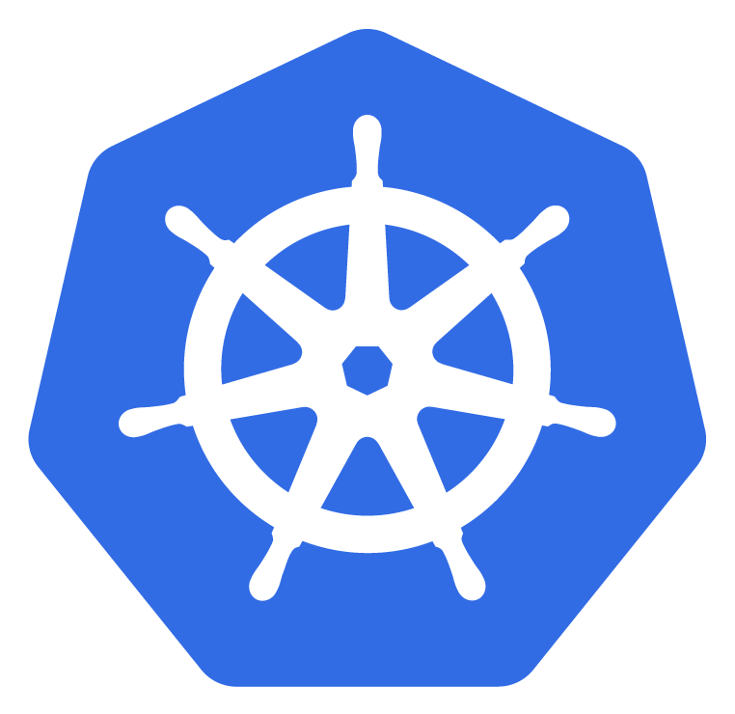
PREFACE
Before we begin, K8S Is a huge and complex framework to work and learn as it has many capabilities and ones that it doesn't poses, 3rd party solutions adds the missing functionality. Learning K8S never stops and even the most professional and experienced devops are still learning new ways to work and implement K8S on a daily base.
In This Course we will learn all the basics of K8S operation and architecture and we end it by building and deploying Frontend And Backend application using Canary release into “Production” and allow each one of you to manage, control and deploy new deployments into K8S. I Hope you’ll enjoy this Course,
Yaniv Cohen - JB Head of devops.
p.s. Note the TBD: along our slides which means that some phrases To Be Discussed in later slides

Slide 7
Questions and notes
To complete this module one need to complete the Docker Operation module
What Do You Know About Docker?
What Do You Know About K8S?
Who Used Docker/K8S For Development / QA / STG / PROD?

Slide 8
- PREFACE -

Slide 9
AGENDA
What is K8S
K8S Concepts & Components
K8S OBJECTS
Basic K8S cluster Orchestration
K8S Deployments
K8S Objects specs
K8S Volumes
K8S Selectors & Affinity & Anti Affinity
K8S Probes
K8S Stateful/less
HELM
Ingress Controllers
In the next 24 Hours we are going to learn about k8s structure and operation

Slide 10
- K8S -
WHAT IT’S ALL ABOUT

Slide 11
K8S - WHAT IT’S ALL ABOUT
From K8S WEBSITE:
“Kubernetes is a portable, extensible open-source platform for managing containerized workloads and services, that facilitates both declarative configuration and automation. It has a large, rapidly growing ecosystem. Kubernetes services, support, and tools are widely available.”

Slide 12
K8S - WHAT IT’S ALL ABOUT
K8S design principles
Kubernetes implements composable control processes
The processes continuously drive the current state of an object towards the provided desired state
Facilitates declarative configuration ( manifest )
Kubernetes extends its feature using pluggable modules ( Plugins / Operators / CRD)

Slide 13
K8S - WHAT IT’S ALL ABOUT
In plain english k8s is:
Container orchestration platform
Environment agnostic solution ( can run on any infrastructure )
Originated by Google Borg
K8S Allows developers / system operators to cut to the cord and truly run a container-centric dev / microservice environment

Slide 14
K8S - WHAT IT’S ALL ABOUT
K8S -
Does not deploy source code and does not build your application - CI/CD Does
Does not provide application-level services, such as middleware (e.g., message buses), data-processing frameworks (for example, Spark), databases (e.g., mysql), caches, nor cluster storage systems (e.g., Ceph) as built-in services
Does not dictate logging, monitoring, or alerting solutions (at least not as good as Prometheus for monitoring and ECK Elastic Cloud K8s)
Does not provide nor mandate a configuration language/system (e.g., jsonnet). It provides a declarative API that may be targeted by arbitrary forms of declarative specifications.
Does not provide nor adopt any comprehensive machine configuration, maintenance, management, or self-healing systems.

Slide 15
- K8S -
Core Concepts & Components

Slide 16
K8S - CORE CONCEPTS
To master K8S like any other framework or system we work on, We are required to have a deep understanding of what makes it tick.
In the next slides we will review and discuss K8S Architecture in details.
Notes:
הקובנקטיס מורכב משני רכיבים שלרוב נמצאים על שרתים שונים: master תמיד מספר אי זוגי, לרוב יותר מאחד עבור יתירות. המאסטר מקבל את ההוראות מהמשתמש ומקצה עבורו worker
Worker מקבל את הפקודות מהמאסטר ומבצע (לדוג' להריץ דוקר)

Slide 17
K8S CORE CONCEPTS - MASTER NODE
CONCEPTS
KUBE-SCHEDULER
KUBE-APISERVER
CLOUD-CONTROLLER-MANAGER
ETCD
KUBE-CONTROLLER-MANAGER
Notes:
רכיבים ב-master:
ETCD מסד נתונים קל משקל, מצוין בשמירת קונפיגורציות.
אם הרכיב תקול – כלום לא יעבוד.
APISERVER שכבת api שעוטפת את מסד הנתונים. אף רכיב של קוברנטיס לא מתקשר ישירות עם ה-ETCD, אלא רק דרך ה-API.
למשתמש יש פקודת kubectl, או Oc ב-openshift כדי לתקשר עם ה-API ולתת הוראות ל-master. ההוראות נשמרות ב-ETCD.
אם הרכיב תקול – כלום לא יעבוד.
SCHEDULER – מחכה ל-event של שינוי ב-ETCD שמחכה עבורו, ומבצע את השינוי הנדרש. למשל – הקמה של pod.
הרכיב משנה את הסטאטוס מ-pending ל-scheduling, עד שיעביר את המשימה ל-worker.
אם הרכיב תקול – הסטאטוס יישאר בpending או scheduling.
ההקצאה ל-worker מתבצעת ב-ETCD, על ה-worker יש agent בשם kubelet שסורק את ה-ETCD ומחפש משימות עבור ה-worker
ה-kubelet הוא עובד בתצורת controller pattern, כלומר כל עוד מתרחש אירוע מסויים, תגיע למצב רצוי (desire state).
ה-kubelet מריץ container engine ושולט דרכו ב-container-ים שהוא מריץ.

Slide 18
K8S - CORE CONCEPTS
Every K8S cluster is made of two types of roles - Master & Node.
While the Master controls and manage our K8S cluster by maintaining our cluster state. Our Node Role maintaining running pods and providing the Kubernetes runtime environment

Slide 19
K8S - CORE CONCEPTS
Understanding K8S system and abstraction
To work with Kubernetes, we use Kubernetes API objects to describe our cluster’s desired state:
what applications or other workloads we want to run
What container images they use, the number of replicas, what network and disk resources we want to make available.
Setting our desired state by creating objects using the Kubernetes API (typically via the command-line interface - “kubectl”)
Once we’ve set our desired state,
Kubernetes Control Plane works to make the cluster’s current state match the desired state

Slide 20
- K8S MASTER -
CORE CONCEPTS

Slide 21
K8S - CORE CONCEPTS
The Kubernetes Master role is a collection of three processes that run on a single node in our cluster ( in production we will deploy it as quorum ).
The process that designated a node to become a master node are:
Kube-apiserver who Validates and configures data for the api objects which include containers, services, replicationcontrollers, and others.
Kube-controller-manager - is a an application control loop that watches the shared state of the cluster through the apiserver and makes changes attempting to move the current state towards the desired state.
Kube-scheduler has the job to take pods [TBD:For now we think about pods as containers] that aren’t bound to a node, and assign them one along with hardware/software/policy constraints

Slide 22
K8S - CORE CONCEPTS
Master node Deep Dive:
K8S Master components are the cluster’s control plane. The Master components make global decisions about the cluster state, and they detect and respond to cluster events (for example, running multiple pods[containers] of our application when required and scale in the number of running pods).

Slide 23
K8S - CORE CONCEPTS
Master node Deep Dive:
The Kubernetes Control Plane consists of a collection of processes running on our cluster
Kube-Apiserver - Exposes the Kubernetes API. It is the front-end for the Kubernetes control plane. It is designed to scale horizontally – that is, it scales by deploying more instances.
ETCD - highly-available key value FILESYSTEM store used as Kubernetes’ backing store for all cluster data
kube-Scheduler - Watches newly created pods that have no node assigned, and selects a node for them to run on. Factors taken into account for scheduling decisions include individual and collective resource requirements, hardware/software/policy constraints, affinity and anti-affinity specifications, data locality, inter-workload interference and deadlines.

Slide 24
K8S - CORE CONCEPTS
Master node Deep Dive:
The Kubernetes Control Plane consists of a collection of processes running on our cluster
Kube-controller-manager which includes separate process but for complexity reduction they are running as one binary
Node Controller - Responsible for noticing and responding when nodes go down
Replication controller - Responsible for maintaining the correct number of pods for every replication controller object in the system
Endpoints Controller - Populates the Endpoints object (that is, joins Services & Pods)
Service account & Token Controllers - Create default accounts and API access tokens for new namespaces

Slide 25
K8S - CORE CONCEPTS
Master node Deep Dive:
Cloud-controller-manager [Used when running on cloud) - runs controllers that interact with the underlying cloud providers. cloud-controller-manager allows cloud vendors code and the Kubernetes core to evolve independent of each other and develops functionality (by the cloud providers) that will be linked to K8S cloud-controller-manger.
The following controllers have cloud provider dependencies
Node Controller: For checking the cloud provider to determine if a node has been deleted in the cloud after it stops responding
Route Controller: For setting up routes in the underlying cloud infrastructure
Service Controller: For creating, updating and deleting cloud provider load balancers
Volume Controller: For creating, attaching, and mounting volumes, and interacting with the cloud provider to orchestrate volumes

Slide 26

- READY TO CONTINUE ? -

Slide 27
- K8S NODE -
[aka minions or worker and today NODE]

Slide 28
K8S CORE CONCEPTS - Worker NODE
K8S NODE
Kubelet
ADDONS: Such as
DNS
WEB UI
Resource Monitoring
Kube-proxy
Container Runtime
Cluster-Level Logging

Slide 29
K8S - CORE CONCEPTS
Node
Node - may be a VM or physical machine, depending on the cluster. Each node has the services necessary to run pods and is managed by the master components. The services on a node include Docker, kubelet and kube-proxy. See The Kubernetes Node section in the architecture design doc for more details.

Slide 30
K8S - CORE CONCEPTS
Node
Each individual non-master node in our cluster runs two K8S processes:
Kubelet - An agent that runs on each node in the cluster. It makes sure that containers are running in a pod. The kubelet takes a set of PodSpecs [TBD: yaml files with declaration on how to deploy our application] that are provided through various mechanisms and ensures that the containers described in those PodSpecs are running and healthy. The kubelet doesn’t manage containers which were not created by Kubernetes.
Kube-proxy - is a network proxy that runs on each node in your cluster, implementing part of the Kubernetes Service concept [TBD:]. kube-proxy maintains network rules on nodes. These network rules allow network communication to your Pods from network sessions inside or outside of your cluster. kube-proxy uses the operating system packet filtering layer if there is one and it’s available. Otherwise, kube-proxy forwards the traffic itself.

Slide 31
K8S - CORE CONCEPTS
Node
Each individual non-master node in our cluster also runs:
Container Runtime - The container runtime is the software that is responsible for running containers. Kubernetes runtimes: Docker , rkt (coreOS) and CRI-O

Slide 32
K8S - CORE CONCEPTS
Addons
DNS - While the other addons are not strictly required, all Kubernetes clusters should have cluster DNS, as many examples rely on it. Cluster DNS is a DNS server, in addition to the other DNS server(s) in your environment, which serves DNS records for Kubernetes services. Containers started by Kubernetes automatically include this DNS server in their DNS searches.
WEB UI - General purpose, web-based UI for Kubernetes clusters. It allows users to manage and troubleshoot applications running in the cluster, as well as the cluster itself
Container Resource monitoring - Records generic time-series metrics about containers in a central database, and provides a UI for browsing that data
Cluster-level Logging - A Cluster-level logging mechanism is responsible for saving container logs to a central log store with search/browsing interface.

Slide 33
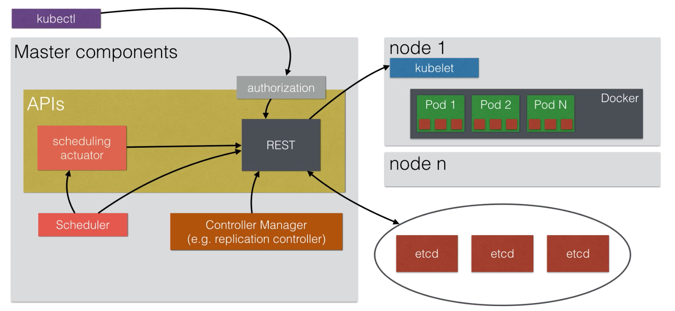
K8S - CORE CONCEPTS
SUMMARY NODE & MASTER

Slide 34
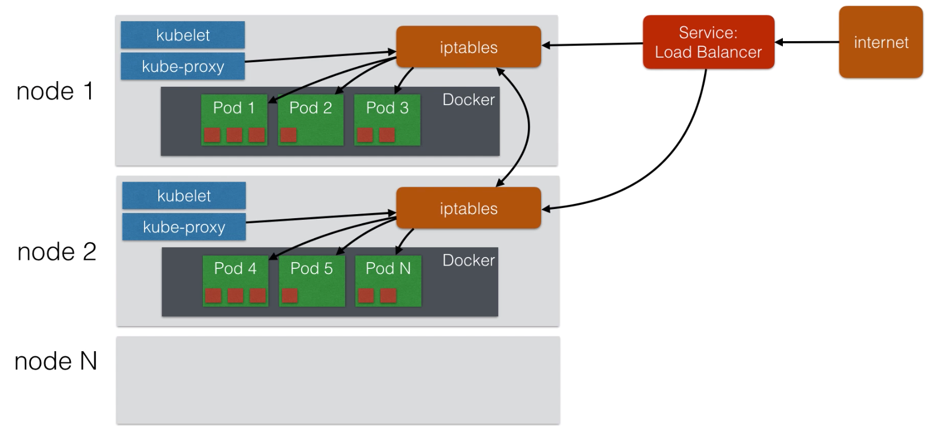
K8S - CORE CONCEPTS
SUMMARY NODE

Slide 35
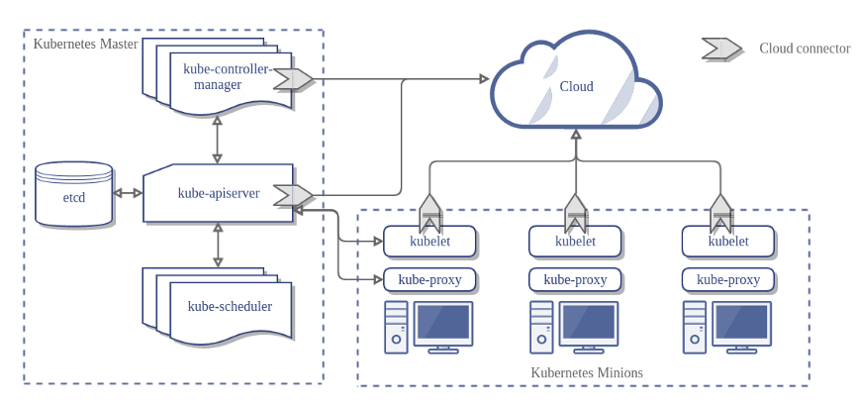
K8S - CORE CONCEPTS
SUMMARY

Slide 36
- K8S -
OBJECTS

Slide 37
K8S - OBJECTS
The following slides discuss and describe the basic building blocks of K8S such as PODS, SERVICES and controllers such as DEPLOYMENTS and Daemonsets.
By the end of each Object we will do a hands on lab so make sure you are connected to your K8S cluster deployed on AWS.

Slide 38
K8S OBJECTS & CONTROLLERS
K8S
POD
NAMESPACE
JOB
DAEMONSET
REPLICASET
SERVICE
VOLUME
STATEFULLSET
DEPLOYMENT

Slide 39
K8S OBJECTS: DEPLOYMENT
Let’s connect to our remote master nodes
With the IP and SSH KEY you received please run the following in git bash: Instruction link: https://docs.google.com/document/d/1h2goNyB8bptKbcSzOUjwc94MI_0iJNvcvuC9TEpPCl8/edit?usp=sharing
$> chmod 400 KEY (only for the first time )
$> ssh -i KEY ubuntu@[remote master ip]
The last command will connect you to the remote K8S master machine, Once connected please run the following command to validate K8S Operation
ip-10.32.3.233> kubectl get nodes ---> expected result should be similar to the below list - 1 Master and 1 Node NAME STATUS ROLES AGE VERSION
host01 Ready master 3m v1.22.6
host02 Ready node 3m v1.22.6

Slide 40
- K8S PODS -

Slide 41
K8S OBJECTS: PODS
POD - A Pod is the basic building block of Kubernetes–the smallest and simplest unit in the Kubernetes object model that you create or deploy. A Pod represents a running process on your cluster. A Pod encapsulates an application container (or, in some cases, multiple containers), storage resources, a unique network IP, and options that govern how the container(s) should run.
The pod is an abstraction layer that allows k8s to manage and group containers using the node kubelet agent

Slide 42
K8S OBJECTS: PODS
There are two ways to describe a POD in a K8S cluster
Pods that run a single container - The “one-container-per-Pod” model is the most common Kubernetes use case; in this case, you can think of a Pod as a wrapper around a single container, and Kubernetes manages the Pods rather than the containers directly
Pods that run multiple containers that need to work together aka as SIDECARS
POD SINGLE CONTAINER
POD 1 MULTI/SIDE CONTAINER
POD 2 MULTI/SIDE CONTAINER
CONTAINER ENGINE
CONTAINER
CONTAINER
A
CONTAINER
B
CONTAINER
A
CONTAINER
B

Slide 43
K8S OBJECTS: PODS
When do we run Multi/SideCar container setup in a pod?
Pods that run multiple containers that need to work together - A Pod might encapsulate an application composed of multiple co-located containers that are tightly coupled and need to share resources such as memory, storage or network with zero latency (multi containers in a pod are always hosted in the same NODE). These co-located containers might form a single cohesive unit of service–one container serving files from a shared volume to the public, while a separate “sidecar” container refreshes or updates those files. The Pod wraps these containers and storage resources together as a single manageable entity.

Slide 44
K8S OBJECTS: PODS
Pods provide two kinds of shared resources for their constituent containers: networking and storage.
Networking - Each Pod is assigned a unique IP address. Every container in a Pod shares the network namespace, including the IP address and network ports. Containers inside a Pod can communicate with one another using localhost. When containers in a Pod communicate with entities outside the Pod, they must coordinate how they use the shared network resources (such as ports).
DOCKER ENGINE
IP:10.32.3.21/16
POD B
CONTAINER
A:80
CONTAINER
B:8080
Communicate directly (localhost)

Slide 45
K8S OBJECTS: PODS
Pods provide two kinds of shared resources for their constituent containers: networking and storage.
Storage - A Pod can specify a set of shared storage volumes. All containers in the Pod can access the shared volumes, allowing those containers to share data. Volumes also allow persistent data in a Pod to survive in case one of the containers within needs to be restarted. [TBD: Volumes advanced and how k8s implement shared storage in a pod and in a cluster}
KUBELET
POD B
POD C
DOCKER ENGINE
CONTAINER
A
CONTAINER
B
CONTAINER
A
CONTAINER
B
SHARED VOLUME
SHARED VOLUME

Slide 46
- LAB - DEPLOY SINGLE POD -

Slide 47
K8S OBJECTS: DEPLOYMENT
Quick Guideline for KUBECTL CLI commands
Almost Every command in kubectl is built in the following way: KUBECTL COMMAND OBJECT/NAME ACTION
Commands example:
$> kubectl get nodes - Get a list of nodes
$> kubectl get pods - Get a list of pods
$> kubectl get deployment - Get a list of deployment
$> kubectl describe [CONTROLER] [NAME OF OBJECT] - Show details of a specific resource or group of resources
$> kubectl run / (create)- Create a deployment
$> kubectl logs -f [POD_NAME] - show the stdout output of the pod you select
$> kubectl exec -ti [POD_NAME] -- [command to run inside the container] - exec a command inside a running container
$> kubectl delete [pods/name] OR [deployments deploymentName]
Additional commands will be learned in the next slides
Additional cheatsheet from k8s: https://kubernetes.io/docs/reference/kubectl/cheatsheet/

Slide 48
K8S OBJECTS: DEPLOYMENT
Handson handle - note there is an error you need to fix
Deploying demo spring application using $> kubectl run …
Instruction:
Command explained: $> kubectl run [podname] --image [repo/image:ver] --port=[app listen port inside the container] (--PORT is valid argument in latest api)
** we need to use the --port argument for exposing the application inside the container to be used by a SERVICE [TBD: Service is the network abstraction layer of k8s and the way to expose an application to the world / cluster]
Instruction for our lab:
Image to deploy: yanivomc/spring-music:e33
pod name: yourname-spring-music
Port: 8080 [This is the port that our spring application listen for requests]
Using the “kubectl run” command above deploy our newly application (my repo: https://hub.docker.com/r/yanivomc/spring-music)

Slide 49
K8S OBJECTS: DEPLOYMENT
Handson handle - note there is an error you need to fix
To debug our problem please run the following commands
Instruction use the following command to get and inspect your pods
Run kubectl get pods
Run kubectl describe pods [pod name]

Slide 50
- K8S DEPLOYMENT -

Slide 51
K8S OBJECTS: DEPLOYMENT
Deployment - A controller that provides declarative UPDATES for Pods and ReplicaSets [TBD: Replicaset define the number of replicas we wants for each deployments PODS}. We describe a desired state in a Deployment object, and the Deployment controller changes the actual state to the desired state at a controlled rate.
We use the deployment controller to basically run our application containers.

Slide 52
- LAB01: DEPLOYING NEW APPLICATION -

Slide 53
K8S OBJECTS: DEPLOYMENT
DEPLOY APPLICATION
EXPLORE KUBECTL
DEBUG OUR DEPLOYMENT
ROLLING UPDATE (DEPLOY NEW VERSION)
SCALE NUMBER OF PODS

Slide 54
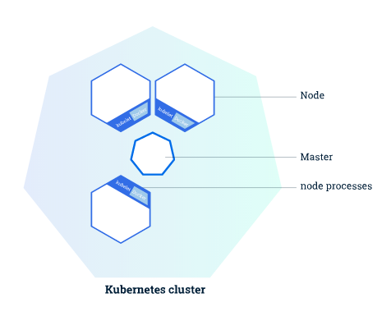
K8S OBJECTS: DEPLOYMENT
Remember?
The Master is responsible for managing & coordinates all the cluster activities such as desire state, scaling, rolling new updates.
A Node is a VM or a physical computer that serves as a worker machine in a Kubernetes cluster
The nodes communicate with the master through the Kubernetes API (using Kubelet agent for communication and management of the node)

Slide 55
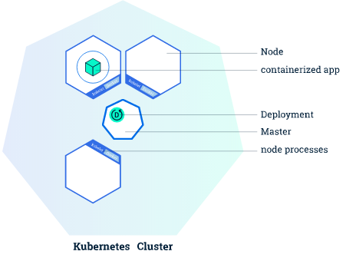
K8S OBJECTS: DEPLOYMENT
DEPLOYMENTS AND PODS
Deployment - A controller that provides declarative updates for Pods and ReplicaSets. We describe a desired state in a Deployment object, and then Deployment controller changes the actual state to the desired state at a controlled rate [TBD: Rolling updates]

Slide 56
K8S OBJECTS: DEPLOYMENT
Quick Guideline for KUBECTL CLI commands
Almost Every command in kubectl is built in the following way: KUBECTL COMMAND OBJECT/NAME ACTION
Commands example:
$> kubectl get nodes - Get a list of nodes
$> kubectl get pods - Get a list of pods
$> kubectl get deployment - Get a list of deployment
$> kubectl describe [CONTROLER] [NAME OF OBJECT] - Show details of a specific resource or group of resources
$> kubectl (run static pod) / (create)- Create a deployment
$> kubectl logs -f [POD_NAME] - show the stdout output of the pod you select
$> kubectl exec -ti [POD_NAME] [command to run inside the container] - exec a command inside a running container
$> kubectl delete [pods/name] OR [deployments deploymentName]
Additional commands will be learned in the next slides
Additional cheatsheet from k8s: https://kubernetes.io/docs/reference/kubectl/cheatsheet/

Slide 57
K8S OBJECTS: DEPLOYMENT
CREATING A NEW DEPLOYMENT
To deploy a new Application we will create k8s Deployment configuration. Which in turn will instruct K8S how to create and update the instances of our application.
Note that once a new application instances are created,
K8S deployment-controller will continuously monitor those instances and if one will fail - it will be replaced by the deployment-controller.

Slide 58
K8S OBJECTS: DEPLOYMENT
Handson handle errors and debug -
Deploying demo spring application using $> kubectl run … ( THERE ARE BUILT IN ERRORS IN THE COMMAND FOR YOU TO DEBUG / SOLVE / CHANGE)
Instruction:
Command explained: $> kubectl run [YOURNAME-deploymentname] --image [repo/image:ver] --port=[app listen port inside the container]
** we need to use the --port argument for exposing the application inside the container to be used by a SERVICE [TBD: Service is the network abstraction layer of k8s and the way to expose an application to the world / cluster]
Instruction for our lab:
Image to deploy: yanivomc/spring-music:latest
Deployment name: yourname-spring-music
Port: 8080 [This is the port that our spring application listen for requests]
Using the “kubectl run” command above deploy our newly application (my repo: https://hub.docker.com/u/yanivomc)

Slide 59
K8S OBJECTS: DEPLOYMENT
Handson -
Exploring our deployed application
Instruction:
List your deployment and see that you have “spring-music” deployment
kubectl get deployments
List Replica Sets
kubectl get replicasets
List your deployments PODS and see that you have 1 pod available
kubectl get pods
Check the logs of your running Pods
kubectl logs -f [PODNAME]
TIP: DEBUG IF FAIL…. kubectl describe…….
kubectl delete deployments [DEPLOYMENT NAME]

Slide 60
K8S OBJECTS: DEPLOYMENT
Handson -
Solution for the deploying command
SOLUTION:
kubectl create deployment spring-music --image=yanivomc/spring-music:latest

Slide 61
K8S OBJECTS: DEPLOYMENT
Handson -
Problem - how do we expose our application to the world so we can browse it ?
SOLUTION: In the next slides we will discuss and review how K8S uses the SERVICES to allow traffic to goes inside our K8S Cluster

Slide 62
K8S OBJECTS: DEPLOYMENT
OTHER OPTIONS TO DO A DEPLOYMENT IN K8S - StatefulSet
When we need to deploy a stateful application we can use the StatefulSet workload API object that helps us manage stateful applications. StatefulSet [TBD: Explained thoroughly later on]
StatefulSets are valuable for applications that require one or more of the following.
Stable, unique network identifiers.
Stable, *persistent storage. Ordered, graceful deployment and scaling.
Ordered, graceful deletion and termination.
Ordered, automated rolling updates.
In details on the next part

Slide 63
K8S OBJECTS: DEPLOYMENT
OTHER OPTIONS TO DO A DEPLOYMENT IN K8S - DaemonSet
A DaemonSet ensures that all (or some) Nodes run a copy of a Pod. As nodes are added to the cluster, Pods are added to them. As nodes are removed from the cluster, those Pods are garbage collected. Deleting a DaemonSet will clean up the Pods it created DaemonSet [TBD: Explained thoroughly later on]
Some typical uses of a DaemonSet are:
running a cluster storage daemon, such as glusterd, ceph, on each node.
running a logs collection daemon on every node, such as fluentd or logstash.
running a node monitoring daemon on every node, such as Prometheus Node Exporter, collectd, Datadog agent, New Relic agent, or Ganglia gmond.
In details on the next part

Slide 64
- K8S SERVICES -
A WINDOW TO THE WORLD

Slide 65
K8S OBJECTS: SERVICES
A Services routes traffic across a set of Pods. Services are the abstraction that allow pods to die and replicate in Kubernetes without impacting your application. Discovery and routing among dependent Pods (such as the frontend and backend components in an application) is handled by Kubernetes Services.

Slide 66
- K8S SERVICE -
WHY DO WE NEED IT?

Slide 67
K8S OBJECTS: SERVICES
Pods have a short lifetime, They are born and when they die, they are not resurrected - therefor there is no guarantee about the IP address they are / will served on.
ReplicationControllers in particular create and destroy Pods dynamically (e.g. when scaling out or in or when doing rolling updates). This could make the communication of microservices hard. Imagine a typical Front End communication with Backend services - how do those frontends find out and keep track of which backends are in that set?

Slide 68
K8S OBJECTS: SERVICES
In the left scenario we need to build a setup in K8S where of SPRING-FE needs to Communicate with the API which in turn writes it’s transaction received from the FE to the MYSQL-DB.
DEPLOYMENT
DEPLOYMENT
PODS
PODS
DEPLOYMENT
NAME:
SPRING-FE
NAME:
API
3
PODS
1
services
NAME:
MYSQL-DB
Problems:
How to tell the FE where are his API endpoints (every POD has its own IP)
We wish to use DNS names
What will happen if our API PODS will scale up or down and their IP’s will change?
API Needs to reach the MYSQL POD with DNS Name
NAME:
SPRING-FE
services
NAME:
API
my-db
API
NAME:
SPRING-FE
NAME:
API
NAME:
API
2
SCALING

Slide 69
K8S OBJECTS: SERVICES
To solve all of those questions and many more K8s has introduced the concept of a Services
which is an abstraction on top of a number of pods, typically requiring to run a proxy on top, for other services to communicate with it via a Virtual IP address. This is where you can configure load balancing for your numerous pods and expose them via a service.

Slide 70
- HARD CONCEPTS UP AHEAD -

Slide 71
K8S OBJECTS: SERVICES
Before we continue to the next Lab - Exposing our services
We got a few critical concepts of the SERVICES object to understand.

Slide 72
K8S OBJECTS: SERVICES
As mentioned before,
Each Pod has a unique IP address, those IPs are not exposed outside the cluster without a Service. Services allow our applications to receive traffic. Services can be exposed in different ways by specifying a type in the ServiceSpec.
The types available for us to use are:
ClusterIP (Default) - Exposes the Service on an internal IP in the cluster only
NodePort - Exposes the Service on the same port of each selected Node in the cluster using NAT. Makes a Service accessible from outside the cluster using <NodeIP>:<NodePort>
LoadBalancer - Creates an external load balancer in the current cloud (if supported) and assigns a fixed, external IP to the Service. Superset of NodePort
ExternalName - Exposes the Service using an arbitrary name by returning a CNAME record with the name.

Slide 73
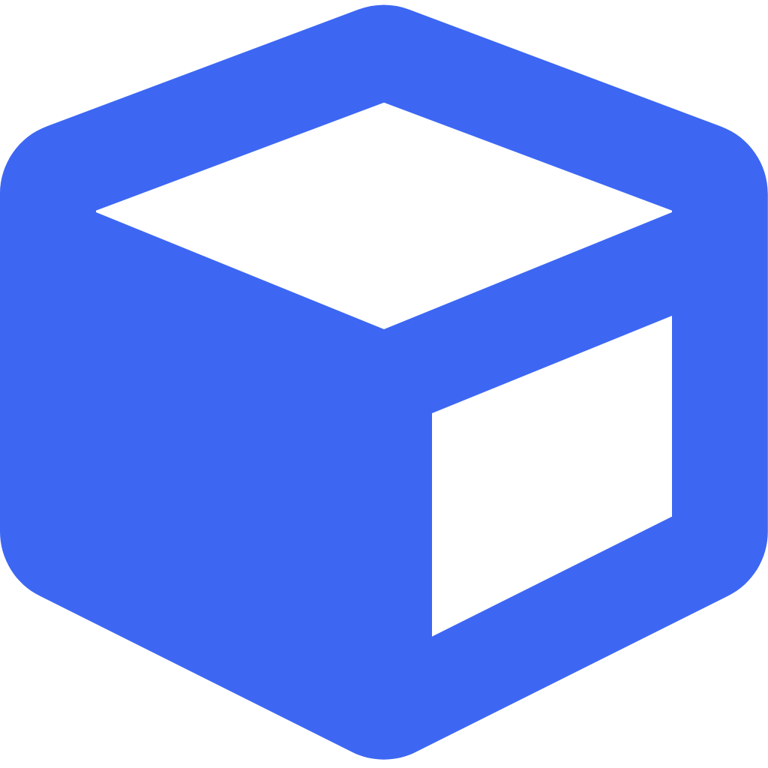
K8S OBJECTS: SERVICES
Lets try and understand how each of them works
fe
ClusterIP - By creating a cluster IP we can allow a client Application to point to BESRV DNS and reach out to all 3 backend PODS under our BESRV ClusterIP Service
SERVICE BESRV 10.40.20.1
10.30.52.2
10.30.52.3
10.30.52.4
POD
NODE

Slide 74
K8S OBJECTS: SERVICES
Lets try and understand how each of them works
NodePort Service creates a VIRTUAL IP with a dedicated Port for the PODS we expose. Using The IP of one or each of our NODES along with the port created by the Services we will be able to reach to our pods from the outside of the cluster.
209.168.32.45:33933
209.168.32.44:33933
SERVICE FESRV
209.168.32.23:33933
10.30.52.2
10.30.52.3
10.30.52.4
POD
NODE

Slide 75


K8S OBJECTS: SERVICES
Lets try and understand how each of them works
LOADBALANCER When hosted on a cloud provider such as AWS, GCP Or AZURE, we can use TYPE LB and Exposes the Service externally using a cloud provider’s load balancer
209.168.32.44:33933
SERVICE BESRV
209.168.32.23:33933
10.30.52.2
10.30.52.3
10.30.52.4
LOADBALANCER
POD
NODE

Slide 76
- LAB02: EXPOSING OUR DEPLOYED APPLICATION -
We will use type: load balancer for this lab

Slide 77
K8S OBJECTS: SERVICE
Quick Guideline for KUBECTL CLI SERVICE
Commands example:
$> kubectl expose deployment/[deployment name] --type=[“NodePort”,”LoadBalancer”…] --port=[source] --target-port=[port] --name=[srv name]
$> kubectl get services OR kubectl get services/[srv name]
$> kubectl get endpoints
$> kubectl describe service/[ srv name] ((( SEE NEXT SLIDE )))
DONT DELETE BEFORE I TELL YOU
$> kubectl delete service/[service name]

Slide 78
K8S OBJECTS: SERVICE
Handson -
Exposing our application with TYPE LoadBalancer
Instruction for our lab:
Create new deployment with yanivomc/spring-music:latest image (SEE SLIDE 59)
Deployment name: use “kubectl get deployments” to get the deploy name of your application
Service name [Will also be the DNS name for other pods to use internally]: YOURNAME-spring-srv
Source Port: 80 [This is the PORT we wish users to use when browsing / connecting to our application]
Target Port: 8080 [This is the port our application listens to inside our container] ( if using morning lab use PORT 80!!!)
Type: LoadBalancer [Case Sensitive]
Run the expose command and than run kubectl describe to view your newly created service...
Please provide the ingress address in our spreadsheet

Slide 79
K8S OBJECTS: SERVICE
Handson -
Exposing our application with TYPE LoadBalancer
Once you ran kubectl describe service/[serviceName] we expect to see something similar to following
Name: yaniv-spring-music
Type: LoadBalancer
IP: 10.233.14.71 # NodePort is based on ClusterIP - This is the ClusterIP
Port: <unset> 80/TCP LoadBalancer Ingress: be-app-alb-1401118259.eu-central-1.elb.amazonaws.com # Browse this DNS to view your website (NOTE HTTP!!)
TargetPort: 8080TCP
NodePort: <unset> 30602/TCP # Dedicated Port that will be exposed on each of our nodes for this service
Endpoints: 10.233.116.71:8080 , 10.233.116.72:8080# The IP[s] of the pods this service manage / Expose [TBD:selectors]
Session Affinity: None
External Traffic Policy: Cluster
Events: <none>

Slide 80
K8S OBJECTS: SERVICE
Handson - Solution
Exposing our application with TYPE LoadBalancer
$> kubectl expose deployment/spring-music --type=LoadBalancer --port=80 --target-port=8080 --name=spring-srv
>>>>> service/spring-srv created
$> kubectl describe services/spring-srv

Slide 81
-SERVICE AND LABELS SELECTOR -

Slide 82
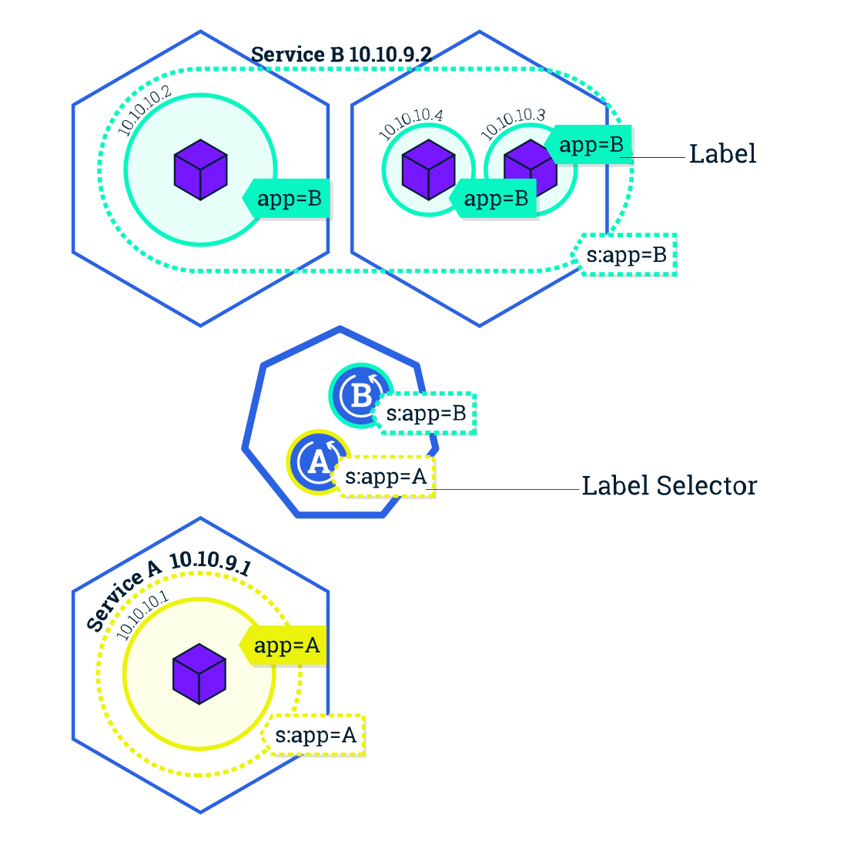
K8S OBJECTS: SERVICES
How does our newly created service knows how to group PODS as his backend?
Services match a set of Pods using labels and selectors, a grouping primitive that allows logical operation on objects in K8S. Labels are key/value pairs attached to objects and can be used in any number of ways

Slide 83
K8S OBJECTS: SERVICES
USING LABELS WITH KUBECTL
Every deploy we create will automatically be labeled as “app=[deployname]”
To Test this we can run:
$> kubectl get deployment -l “app=spring-music”
$> kubectl get all -l “app=spring-music”
$> kubectl get srv all -l “app=spring-music” # srv is a shortcut for services

Slide 84
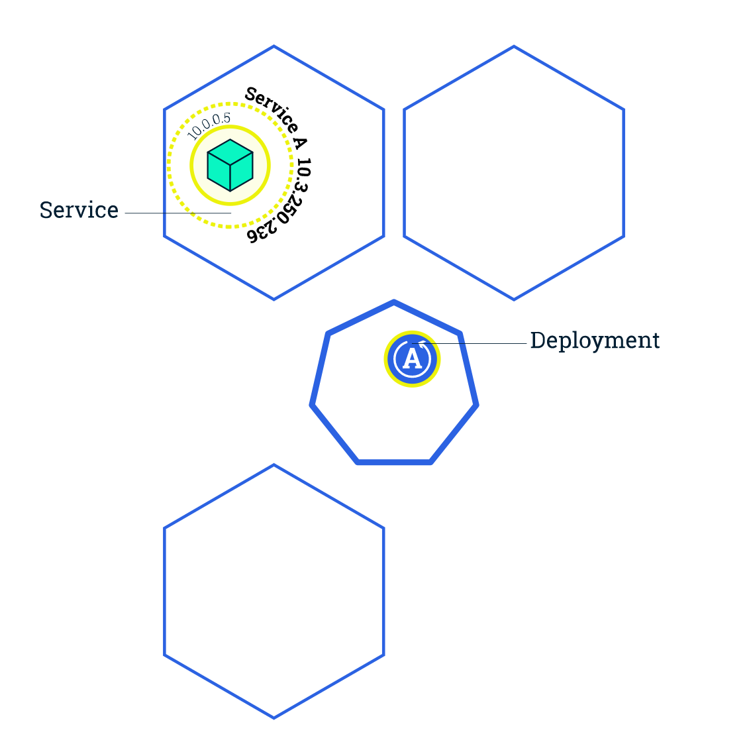
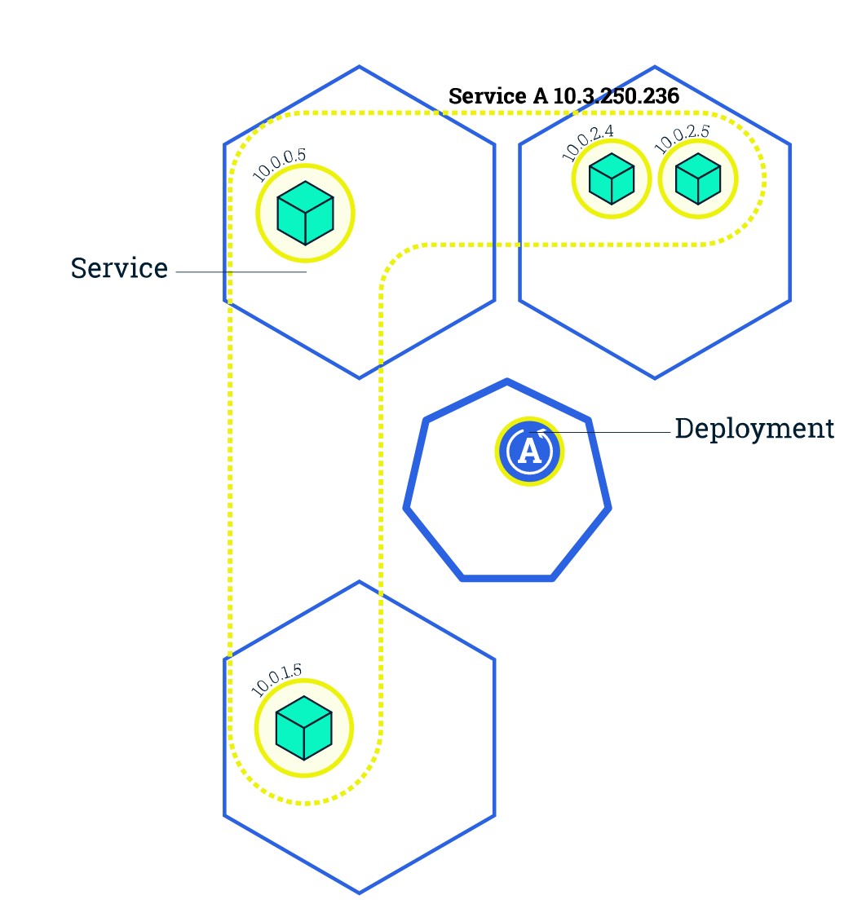
K8S OBJECTS: SERVICES
SCALING OUR APPLICATION

Slide 85
K8S OBJECTS: SERVICES
SCALING OUR APPLICATION
We can scale our number of pods by running the following command
Create a new deployment if not exists already - Look at slide number: 54 + Expose your deployment
# Scale command ( don't scale more than 3 )
$ >kubectl scale deployment/[name] --replicas=[num]
# Get detailed deployment status and pods per node
$ > kubectl get pods -o wide
# View how the number of endpoints under our service changed
$ > kubectl describe services/spring-music
# Get number of pods
# Run describe to view events and replicas status
$ > Kubectl describe deployment/[name]
Delete deployment and service
$> kubectl delete deployment/name && kubectl delete svc/name

Slide 86
K8S BASIC -
THE JOURNEY STARTS HERE

Slide 87
Developed by Yaniv cohen
Ex CEO , CTO and SVP Engineering for multiple Israeli startups with 25 Years experience in the world of Software architecture , IT and Management.
Founder & CEO of :
DevopShift Israel - Devops solutions & consulting
Founder & CEO of of DevopShift Vienna
Im also Acting as Head of Of Devops for JohnBryce - Israeli biggest computer academy.
Last but not least a Devops and Microservices design lecturer around the world (12,000 Students in just the last 5 Years).
Linkedin profile:
http://bit.ly/yaniv_linkedin
EMAIL: yaniv@ynot.work

Slide 88
How do we migrate to K8S from Old school monolith steps:
Developing inside containers as early possible
Docker compose > QA
Create metrics
Train all rnd, support , product ,ops personal with k8s, microservices and executives!!!
Architect will decide on the K8S Tech stack
Devops build k8s local installation per developer
Forget regression tests - they will slow you down!
Implement Chaos testing
Use Multistage builds for your delivery / DockerFiles
Deploy to STG or long running env (K8S)?
Zero downtime + zero hands - Support Canary release
PRE PRODUCTION DEPLOYMENT
For specific client (Canary release)
Wrapped by Monitoring facility (such as https://www.jaegertracing.io/)
Enough metrics and knowledge how to maintain, debug and troubleshoot issues

Slide 89
Configuration Auto Scaling capability
Go production
Full capability to rollback to old infrastructure.

Slide 90
K8S OPERATION -
GETTING THINGS DONE WITH ALMIGHTY K8S

Slide 91
PREFACE
Before we begin, K8S Is a huge and complex framework to work and learn as it has many capabilities and ones that it doesn't poses, 3rd party solutions adds the missing functionality. Learning K8S never stops and even the most professional and experienced devops are still learning new ways to work and implement K8S on a daily base.
In This Course we will learn all the basics of K8S operation and architecture and we end it by building and deploying Frontend And Backend application using Canary release into “Production” and allow each one of you to manage, control and deploy new deployments into K8S. I Hope you’ll enjoy this Course,
Yaniv Cohen - JB Head of devops.
p.s. Note the TBD: along our slides which means that some phrases To Be Discussed in later slides

Slide 92
- PREFACE -

Slide 93
AGENDA
What is K8S
K8S Concepts & Components
K8S OBJECTS
Basic K8S cluster Orchestration
K8S Deployments
K8S Objects specs
K8S Volumes
K8S Selectors & Affinity & Anti Affinity
K8S Probes
K8S Stateful/less
HELM
Ingress Controllers
In the next 24 Hours we are going to learn about k8s structure and operation

Slide 94
- K8S -
WHAT IT’S ALL ABOUT

Slide 95
K8S - WHAT IT’S ALL ABOUT
From K8S WEBSITE:
“Kubernetes is a portable, extensible open-source platform for managing containerized workloads and services, that facilitates both declarative configuration and automation. It has a large, rapidly growing ecosystem. Kubernetes services, support, and tools are widely available.”

Slide 96
K8S - WHAT IT’S ALL ABOUT
K8S design principles
Kubernetes implements composable control processes
The processes continuously drive the current state of an object towards the provided desired state
Facilitates declarative configuration ( manifest )
Kubernetes extends its feature using pluggable modules ( Plugins / Operators / CRD)

Slide 97
K8S - WHAT IT’S ALL ABOUT
In plain english k8s is:
Container orchestration platform
Environment agnostic solution ( can run on any infrastructure )
Originated by Google Borg
K8S Allows developers / system operators to cut to the cord and truly run a container-centric dev / microservice environment

Slide 98
K8S - WHAT IT’S ALL ABOUT
K8S -
Does not deploy source code and does not build your application - CI/CD Does
Does not provide application-level services, such as middleware (e.g., message buses), data-processing frameworks (for example, Spark), databases (e.g., mysql), caches, nor cluster storage systems (e.g., Ceph) as built-in services
Does not dictate logging, monitoring, or alerting solutions (at least not as good as Prometheus for monitoring and ECK Elastic Cloud K8s)
Does not provide nor mandate a configuration language/system (e.g., jsonnet). It provides a declarative API that may be targeted by arbitrary forms of declarative specifications.
Does not provide nor adopt any comprehensive machine configuration, maintenance, management, or self-healing systems.

Slide 99
- K8S -
Core Concepts & Components

Slide 100
K8S - CORE CONCEPTS
To master K8S like any other framework or system we work on, We are required to have a deep understanding of what makes it tick.
In the next slides we will review and discuss K8S Architecture in details.

Slide 101
K8S CORE CONCEPTS - MASTER NODE
CONCEPTS
KUBE-SCHEDULER
KUBE-APISERVER
CLOUD-CONTROLLER-MANAGER
ETCD
KUBE-CONTROLLER-MANAGER

Slide 102
K8S - CORE CONCEPTS
Every K8S cluster is made of two types of roles - Master & Node.
While the Master controls and manage our K8S cluster by maintaining our cluster state. Our Node Role maintaining running pods and providing the Kubernetes runtime environment

Slide 103
K8S - CORE CONCEPTS
Understanding K8S system and abstraction
To work with Kubernetes, we use Kubernetes API objects to describe our cluster’s desired state:
what applications or other workloads we want to run
What container images they use, the number of replicas, what network and disk resources we want to make available.
Setting our desired state by creating objects using the Kubernetes API (typically via the command-line interface - “kubectl”)
Once we’ve set our desired state,
Kubernetes Control Plane works to make the cluster’s current state match the desired state

Slide 104
- K8S MASTER -
CORE CONCEPTS

Slide 105
K8S - CORE CONCEPTS
The Kubernetes Master role is a collection of three processes that run on a single node in our cluster ( in production we will deploy it as quorum ).
The process that designated a node to become a master node are:
Kube-apiserver who Validates and configures data for the api objects which include containers, services, replicationcontrollers, and others.
Kube-controller-manager - is a an application control loop that watches the shared state of the cluster through the apiserver and makes changes attempting to move the current state towards the desired state.
Kube-scheduler has the job to take pods [TBD:For now we think about pods as containers] that aren’t bound to a node, and assign them one along with hardware/software/policy constraints

Slide 106
K8S - CORE CONCEPTS
Master node Deep Dive:
K8S Master components are the cluster’s control plane. The Master components make global decisions about the cluster state, and they detect and respond to cluster events (for example, running multiple pods[containers] of our application when required and scale in the number of running pods).

Slide 107
K8S - CORE CONCEPTS
Master node Deep Dive:
The Kubernetes Control Plane consists of a collection of processes running on our cluster
Kube-Apiserver - Exposes the Kubernetes API. It is the front-end for the Kubernetes control plane. It is designed to scale horizontally – that is, it scales by deploying more instances.
ETCD - highly-available key value FILESYSTEM store used as Kubernetes’ backing store for all cluster data
kube-Scheduler - Watches newly created pods that have no node assigned, and selects a node for them to run on. Factors taken into account for scheduling decisions include individual and collective resource requirements, hardware/software/policy constraints, affinity and anti-affinity specifications, data locality, inter-workload interference and deadlines.

Slide 108
K8S - CORE CONCEPTS
Master node Deep Dive:
The Kubernetes Control Plane consists of a collection of processes running on our cluster
Kube-controller-manager which includes separate process but for complexity reduction they are running as one binary
Node Controller - Responsible for noticing and responding when nodes go down
Replication controller - Responsible for maintaining the correct number of pods for every replication controller object in the system
Endpoints Controller - Populates the Endpoints object (that is, joins Services & Pods)
Service account & Token Controllers - Create default accounts and API access tokens for new namespaces

Slide 109
K8S - CORE CONCEPTS
Master node Deep Dive:
Cloud-controller-manager [Used when running on cloud) - runs controllers that interact with the underlying cloud providers. cloud-controller-manager allows cloud vendors code and the Kubernetes core to evolve independent of each other and develops functionality (by the cloud providers) that will be linked to K8S cloud-controller-manger.
The following controllers have cloud provider dependencies
Node Controller: For checking the cloud provider to determine if a node has been deleted in the cloud after it stops responding
Route Controller: For setting up routes in the underlying cloud infrastructure
Service Controller: For creating, updating and deleting cloud provider load balancers
Volume Controller: For creating, attaching, and mounting volumes, and interacting with the cloud provider to orchestrate volumes

Slide 110
ETCD -

Slide 111
K8S - CORE CONCEPTS
ETCD Functionality in Kubernetes
ETCD is a distributed key-value store that plays a critical role in the functioning of Kubernetes.
It serves as the primary data store for storing cluster configuration and state information.
ETCD is a highly available and reliable database that ensures the resilience and consistency of the Kubernetes control plane.
ETCD stores critical data such as:
Cluster configuration settings
API objects (pods, services, deployments, etc.)
Service discovery information
Secrets, ConfigMaps, and other important resources
ETCD provides the source of truth for the Kubernetes cluster, allowing for reliable cluster operations.

Slide 112
K8S - CORE CONCEPTS
ETCD Functionality in Kubernetes
ETCD offers several key functionalities that are essential for Kubernetes:
Cluster Coordination: ETCD facilitates communication and coordination among Kubernetes control plane components, ensuring consistency and synchronization.
Service Discovery: ETCD enables service discovery by storing and providing access to information about the services running in the cluster.
Configuration Management: ETCD stores and manages configuration settings, allowing for dynamic updates and configuration changes.
High Availability: ETCD implements a distributed consensus algorithm (Raft) to ensure high availability and fault tolerance.
Data Persistence: ETCD persists data to disk, ensuring that cluster state information is retained even in the event of node failures or restarts.

Slide 113
K8S - CORE CONCEPTS
ETCD Functionality in Kubernetes
In Summary: ETCD's functionalities are crucial for the stability, scalability, and reliability of Kubernetes clusters.
Its ability to maintain a consistent and up-to-date cluster state helps in achieving efficient orchestration and management of containerized applications.

Slide 114
- READY TO CONTINUE ? -

Slide 115
- K8S NODE -
[aka minions or worker and today NODE]

Slide 116
K8S CORE CONCEPTS - Worker NODE
K8S NODE
Kubelet
ADDONS: Such as
DNS
WEB UI
Resource Monitoring
Kube-proxy
Container Runtime
Cluster-Level Logging

Slide 117
K8S - CORE CONCEPTS
Node
Node - may be a VM or physical machine, depending on the cluster. Each node has the services necessary to run pods and is managed by the master components. The services on a node include Docker, kubelet and kube-proxy. See The Kubernetes Node section in the architecture design doc for more details.

Slide 118
K8S - CORE CONCEPTS
Node
Each individual non-master node in our cluster runs two K8S processes:
Kubelet - An agent that runs on each node in the cluster. It makes sure that containers are running in a pod. The kubelet takes a set of PodSpecs [TBD: yaml files with declaration on how to deploy our application] that are provided through various mechanisms and ensures that the containers described in those PodSpecs are running and healthy. The kubelet doesn’t manage containers which were not created by Kubernetes.
Kube-proxy - is a network proxy that runs on each node in your cluster, implementing part of the Kubernetes Service concept [TBD:]. kube-proxy maintains network rules on nodes. These network rules allow network communication to your Pods from network sessions inside or outside of your cluster. kube-proxy uses the operating system packet filtering layer if there is one and it’s available. Otherwise, kube-proxy forwards the traffic itself.

Slide 119
K8S - CORE CONCEPTS
Node
Each individual non-master node in our cluster also runs:
Container Runtime - The container runtime is the software that is responsible for running containers. Kubernetes runtimes: Docker , rkt (coreOS) and CRI-O

Slide 120
K8S - CORE CONCEPTS
Addons
DNS - While the other addons are not strictly required, all Kubernetes clusters should have cluster DNS, as many examples rely on it. Cluster DNS is a DNS server, in addition to the other DNS server(s) in your environment, which serves DNS records for Kubernetes services. Containers started by Kubernetes automatically include this DNS server in their DNS searches.
WEB UI - General purpose, web-based UI for Kubernetes clusters. It allows users to manage and troubleshoot applications running in the cluster, as well as the cluster itself
Container Resource monitoring - Records generic time-series metrics about containers in a central database, and provides a UI for browsing that data
Cluster-level Logging - A Cluster-level logging mechanism is responsible for saving container logs to a central log store with search/browsing interface.

Slide 121
K8S - CORE CONCEPTS
SUMMARY NODE & MASTER

Slide 122
K8S - CORE CONCEPTS
SUMMARY NODE

Slide 123
K8S - CORE CONCEPTS
SUMMARY

Slide 124
- K8S -
OBJECTS

Slide 125
K8S - OBJECTS
The following slides discuss and describe the basic building blocks of K8S such as PODS, SERVICES and controllers such as DEPLOYMENTS and Daemonsets.
By the end of each Object we will do a hands on lab so make sure you are connected to your K8S cluster deployed on AWS.

Slide 126
K8S OBJECTS & CONTROLLERS
K8S
POD
NAMESPACE
JOB
DAEMONSET
REPLICASET
SERVICE
VOLUME
STATEFULLSET
DEPLOYMENT

Slide 127
K8S OBJECTS: DEPLOYMENT
Let’s connect to our remote master nodes
Server Link: http://bit.ly/docker-servers

Slide 128
- K8S PODS -

Slide 129
K8S OBJECTS: PODS
POD - A Pod is the basic building block of Kubernetes–the smallest and simplest unit in the Kubernetes object model that you create or deploy. A Pod represents a running process on your cluster. A Pod encapsulates an application container (or, in some cases, multiple containers), storage resources, a unique network IP, and options that govern how the container(s) should run.
The pod is an abstraction layer that allows k8s to manage and group containers using the node kubelet agent

Slide 130
K8S OBJECTS: PODS
There are two ways to describe a POD in a K8S cluster
Pods that run a single container - The “one-container-per-Pod” model is the most common Kubernetes use case; in this case, you can think of a Pod as a wrapper around a single container, and Kubernetes manages the Pods rather than the containers directly
Pods that run multiple containers that need to work together aka as SIDECARS
POD SINGLE CONTAINER
POD 1 MULTI/SIDE CONTAINER
POD 2 MULTI/SIDE CONTAINER
CONTAINER ENGINE
CONTAINER
CONTAINER
A
CONTAINER
B
CONTAINER
A
CONTAINER
B

Slide 131
K8S OBJECTS: PODS
When do we run Multi/SideCar container setup in a pod?
Pods that run multiple containers that need to work together - A Pod might encapsulate an application composed of multiple co-located containers that are tightly coupled and need to share resources such as memory, storage or network with zero latency (multi containers in a pod are always hosted in the same NODE). These co-located containers might form a single cohesive unit of service–one container serving files from a shared volume to the public, while a separate “sidecar” container refreshes or updates those files. The Pod wraps these containers and storage resources together as a single manageable entity.

Slide 132
K8S OBJECTS: PODS
Pods provide two kinds of shared resources for their constituent containers: networking and storage.
Networking - Each Pod is assigned a unique IP address. Every container in a Pod shares the network namespace, including the IP address and network ports. Containers inside a Pod can communicate with one another using localhost. When containers in a Pod communicate with entities outside the Pod, they must coordinate how they use the shared network resources (such as ports).
DOCKER ENGINE
IP:10.32.3.21/16
POD B
CONTAINER
A:80
CONTAINER
B:8080
Communicate directly (localhost)

Slide 133
K8S OBJECTS: PODS
Pods provide two kinds of shared resources for their constituent containers: networking and storage.
Storage - A Pod can specify a set of shared storage volumes. All containers in the Pod can access the shared volumes, allowing those containers to share data. Volumes also allow persistent data in a Pod to survive in case one of the containers within needs to be restarted. [TBD: Volumes advanced and how k8s implement shared storage in a pod and in a cluster}
KUBELET
POD B
POD C
DOCKER ENGINE
CONTAINER
A
CONTAINER
B
CONTAINER
A
CONTAINER
B
SHARED VOLUME
SHARED VOLUME

Slide 134
- LAB - DEPLOY SINGLE POD -

Slide 135
K8S OBJECTS: DEPLOYMENT
Quick Guideline for KUBECTL CLI commands
Almost Every command in kubectl is built in the following way: KUBECTL COMMAND OBJECT/NAME ACTION
Commands example:
$> kubectl get nodes - Get a list of nodes
$> kubectl get pods - Get a list of pods
$> kubectl get deployment - Get a list of deployment
$> kubectl describe [CONTROLER] [NAME OF OBJECT] - Show details of a specific resource or group of resources
$> kubectl run / (create)- Create a deployment
$> kubectl logs -f [POD_NAME] - show the stdout output of the pod you select
$> kubectl exec -ti [POD_NAME] -- [command to run inside the container] - exec a command inside a running container
$> kubectl delete [pods/name] OR [deployments deploymentName]
Additional commands will be learned in the next slides
Additional cheatsheet from k8s: https://kubernetes.io/docs/reference/kubectl/cheatsheet/

Slide 136
K8S OBJECTS: DEPLOYMENT
Handson handle - note there is an error you need to fix
Deploying demo spring application using $> kubectl run …
Instruction:
Command explained: $> kubectl run [podname] --image [repo/image:ver] --port=[app listen port inside the container] (--PORT is valid argument in latest api)
** we need to use the --port argument for exposing the application inside the container to be used by a SERVICE [TBD: Service is the network abstraction layer of k8s and the way to expose an application to the world / cluster]
Instruction for our lab:
Image to deploy: yanivomc/spring-music:e33
pod name: yourname-spring-music
Port: 8080 [This is the port that our spring application listen for requests]
Using the “kubectl run” command above deploy our newly application (my repo: https://hub.docker.com/r/yanivomc/spring-music)

Slide 137
K8S OBJECTS: DEPLOYMENT
Handson handle - note there is an error you need to fix
To debug our problem please run the following commands
Instruction use the following command to get and inspect your pods
Run kubectl get pods
Run kubectl describe pods [pod name]

Slide 138
- K8S DEPLOYMENT -

Slide 139
K8S OBJECTS: DEPLOYMENT
Deployment - A controller that provides declarative UPDATES for Pods and ReplicaSets [TBD: Replicaset define the number of replicas we wants for each deployments PODS}. We describe a desired state in a Deployment object, and the Deployment controller changes the actual state to the desired state at a controlled rate.
We use the deployment controller to basically run our application containers.

Slide 140
- LAB01: DEPLOYING NEW APPLICATION -

Slide 141
K8S OBJECTS: DEPLOYMENT
DEPLOY APPLICATION
EXPLORE KUBECTL
DEBUG OUR DEPLOYMENT
ROLLING UPDATE (DEPLOY NEW VERSION)
SCALE NUMBER OF PODS

Slide 142
K8S OBJECTS: DEPLOYMENT
Remember?
The Master is responsible for managing & coordinates all the cluster activities such as desire state, scaling, rolling new updates.
A Node is a VM or a physical computer that serves as a worker machine in a Kubernetes cluster
The nodes communicate with the master through the Kubernetes API (using Kubelet agent for communication and management of the node)

Slide 143
K8S OBJECTS: DEPLOYMENT
DEPLOYMENTS AND PODS
Deployment - A controller that provides declarative updates for Pods and ReplicaSets. We describe a desired state in a Deployment object, and then Deployment controller changes the actual state to the desired state at a controlled rate [TBD: Rolling updates]

Slide 144
K8S OBJECTS: DEPLOYMENT
Quick Guideline for KUBECTL CLI commands
Almost Every command in kubectl is built in the following way: KUBECTL COMMAND OBJECT/NAME ACTION
Commands example:
$> kubectl get nodes - Get a list of nodes
$> kubectl get pods - Get a list of pods
$> kubectl get deployment - Get a list of deployment
$> kubectl describe [CONTROLER] [NAME OF OBJECT] - Show details of a specific resource or group of resources
$> kubectl (run static pod) / (create)- Create a deployment
$> kubectl logs -f [POD_NAME] - show the stdout output of the pod you select
$> kubectl exec -ti [POD_NAME] [command to run inside the container] - exec a command inside a running container
$> kubectl delete [pods/name] OR [deployments deploymentName]
Additional commands will be learned in the next slides
Additional cheatsheet from k8s: https://kubernetes.io/docs/reference/kubectl/cheatsheet/

Slide 145
K8S OBJECTS: DEPLOYMENT
CREATING A NEW DEPLOYMENT
To deploy a new Application we will create k8s Deployment configuration. Which in turn will instruct K8S how to create and update the instances of our application.
Note that once a new application instances are created,
K8S deployment-controller will continuously monitor those instances and if one will fail - it will be replaced by the deployment-controller.

Slide 146
K8S OBJECTS: DEPLOYMENT
Handson handle errors and debug -
Deploying demo spring application using $> kubectl run … ( THERE ARE BUILT IN ERRORS IN THE COMMAND FOR YOU TO DEBUG / SOLVE / CHANGE)
Instruction:
Command explained: $> kubectl run [YOURNAME-deploymentname] --image [repo/image:ver] --port=[app listen port inside the container]
** we need to use the --port argument for exposing the application inside the container to be used by a SERVICE [TBD: Service is the network abstraction layer of k8s and the way to expose an application to the world / cluster]
Instruction for our lab:
Image to deploy: yanivomc/spring-music:latest
Deployment name: yourname-spring-music
Port: 8080 [This is the port that our spring application listen for requests]
Using the “kubectl run” command above deploy our newly application (my repo: https://hub.docker.com/u/yanivomc)

Slide 147
K8S OBJECTS: DEPLOYMENT
Handson -
Exploring our deployed application
Instruction:
List your deployment and see that you have “spring-music” deployment
kubectl get deployments
List Replica Sets
kubectl get replicasets
List your deployments PODS and see that you have 1 pod available
kubectl get pods
Check the logs of your running Pods
kubectl logs -f [PODNAME]
TIP: DEBUG IF FAIL…. kubectl describe…….
kubectl delete deployments [DEPLOYMENT NAME]

Slide 148
K8S OBJECTS: DEPLOYMENT
Handson -
Solution for the deploying command
SOLUTION:
kubectl create deployment spring-music --image=yanivomc/spring-music:latest

Slide 149
K8S OBJECTS: DEPLOYMENT
Handson -
Problem - how do we expose our application to the world so we can browse it ?
SOLUTION: In the next slides we will discuss and review how K8S uses the SERVICES to allow traffic to goes inside our K8S Cluster

Slide 150
K8S OBJECTS: DEPLOYMENT
OTHER OPTIONS TO DO A DEPLOYMENT IN K8S - StatefulSet
When we need to deploy a stateful application we can use the StatefulSet workload API object that helps us manage stateful applications. StatefulSet [TBD: Explained thoroughly later on using Manifests]
StatefulSets are valuable for applications that require one or more of the following.
Stable, unique network identifiers.
Stable, *persistent storage. Ordered, graceful deployment and scaling.
Ordered, graceful deletion and termination.
Ordered, automated rolling updates.
In details on the next part

Slide 151
K8S OBJECTS: DEPLOYMENT
OTHER OPTIONS TO DO A DEPLOYMENT IN K8S - DaemonSet
A DaemonSet ensures that all (or some) Nodes run a copy of a Pod. As nodes are added to the cluster, Pods are added to them. As nodes are removed from the cluster, those Pods are garbage collected. Deleting a DaemonSet will clean up the Pods it created DaemonSet [TBD: Explained thoroughly later on using Manifests]
Some typical uses of a DaemonSet are:
running a cluster storage daemon, such as glusterd, ceph, on each node.
running a logs collection daemon on every node, such as fluentd or logstash.
running a node monitoring daemon on every node, such as Prometheus Node Exporter, collectd, Datadog agent, New Relic agent, or Ganglia gmond.
In details on the next part

Slide 152
- K8S SERVICES -
A WINDOW TO THE WORLD

Slide 153
K8S OBJECTS: SERVICES
A Services routes traffic across a set of Pods. Services are the abstraction that allow pods to die and replicate in Kubernetes without impacting your application. Discovery and routing among dependent Pods (such as the frontend and backend components in an application) is handled by Kubernetes Services.

Slide 154
- K8S SERVICE -
WHY DO WE NEED IT?

Slide 155
K8S OBJECTS: SERVICES
Pods have a short lifetime, They are born and when they die, they are not resurrected - therefor there is no guarantee about the IP address they are / will served on.
ReplicationControllers in particular create and destroy Pods dynamically (e.g. when scaling out or in or when doing rolling updates). This could make the communication of microservices hard. Imagine a typical Front End communication with Backend services - how do those frontends find out and keep track of which backends are in that set?

Slide 156
K8S OBJECTS: SERVICES
In the left scenario we need to build a setup in K8S where of SPRING-FE needs to Communicate with the API which in turn writes it’s transaction received from the FE to the MYSQL-DB.
DEPLOYMENT
DEPLOYMENT
PODS
PODS
DEPLOYMENT
NAME:
SPRING-FE
NAME:
API
3
PODS
1
services
NAME:
MYSQL-DB
Problems:
How to tell the FE where are his API endpoints (every POD has its own IP)
We wish to use DNS names
What will happen if our API PODS will scale up or down and their IP’s will change?
API Needs to reach the MYSQL POD with DNS Name
NAME:
SPRING-FE
services
NAME:
API
my-db
API
NAME:
SPRING-FE
NAME:
API
NAME:
API
2
SCALING

Slide 157
K8S OBJECTS: SERVICES
To solve all of those questions and many more K8s has introduced the concept of a Services
which is an abstraction on top of a number of pods, typically requiring to run a proxy on top, for other services to communicate with it via a Virtual IP address. This is where you can configure load balancing for your numerous pods and expose them via a service.

Slide 158
- HARD CONCEPTS UP AHEAD -

Slide 159
K8S OBJECTS: SERVICES
Before we continue to the next Lab - Exposing our services
We got a few critical concepts of the SERVICES object to understand.

Slide 160
K8S OBJECTS: SERVICES
As mentioned before,
Each Pod has a unique IP address, those IPs are not exposed outside the cluster without a Service. Services allow our applications to receive traffic. Services can be exposed in different ways by specifying a type in the ServiceSpec.
The types available for us to use are:
ClusterIP (Default) - Exposes the Service on an internal IP in the cluster only
NodePort - Exposes the Service on the same port of each selected Node in the cluster using NAT. Makes a Service accessible from outside the cluster using <NodeIP>:<NodePort>
LoadBalancer - Creates an external load balancer in the current cloud (if supported) and assigns a fixed, external IP to the Service. Superset of NodePort
ExternalName - Exposes the Service using an arbitrary name by returning a CNAME record with the name.

Slide 161
K8S OBJECTS: SERVICES
Lets try and understand how each of them works
fe
ClusterIP - By creating a cluster IP we can allow a client Application to point to BESRV DNS and reach out to all 3 backend PODS under our BESRV ClusterIP Service
SERVICE BESRV 10.40.20.1
10.30.52.2
10.30.52.3
10.30.52.4
POD
NODE

Slide 162
K8S OBJECTS: SERVICES
Lets try and understand how each of them works
NodePort Service creates a VIRTUAL IP with a dedicated Port for the PODS we expose. Using The IP of one or each of our NODES along with the port created by the Services we will be able to reach to our pods from the outside of the cluster.
209.168.32.45:33933
209.168.32.44:33933
SERVICE FESRV
209.168.32.23:33933
10.30.52.2
10.30.52.3
10.30.52.4
POD
NODE

Slide 163
K8S OBJECTS: SERVICES
Lets try and understand how each of them works
LOADBALANCER When hosted on a cloud provider such as AWS, GCP Or AZURE, we can use TYPE LB and Exposes the Service externally using a cloud provider’s load balancer
209.168.32.44:33933
SERVICE BESRV
209.168.32.23:33933
10.30.52.2
10.30.52.3
10.30.52.4
LOADBALANCER
POD
NODE

Slide 164
- LAB02: EXPOSING OUR DEPLOYED APPLICATION -
We will use type: load balancer for this lab

Slide 165
K8S OBJECTS: SERVICE
Quick Guideline for KUBECTL CLI SERVICE
Commands example:
$> kubectl expose deployment/[deployment name] --type=[“NodePort”,”LoadBalancer”…] --port=[source] --target-port=[port] --name=[srv name]
$> kubectl get services OR kubectl get services/[srv name]
$> kubectl get endpoints
$> kubectl describe service/[ srv name] ((( SEE NEXT SLIDE )))
DONT DELETE BEFORE I TELL YOU
$> kubectl delete service/[service name]

Slide 166
K8S OBJECTS: SERVICE
Handson -
Exposing our application with TYPE LoadBalancer
Instruction for our lab:
Create new deployment with yanivomc/spring-music:latest image (SEE SLIDE 59)
Deployment name: use “kubectl get deployments” to get the deploy name of your application
Service name [Will also be the DNS name for other pods to use internally]: YOURNAME-spring-srv
Source Port: 80 [This is the PORT we wish users to use when browsing / connecting to our application]
Target Port: 8080 [This is the port our application listens to inside our container] ( if using morning lab use PORT 80!!!)
Type: LoadBalancer [Case Sensitive]
Run the expose command and than run kubectl describe to view your newly created service...
Please provide the ingress address in our spreadsheet

Slide 167
K8S OBJECTS: SERVICE
Handson -
Exposing our application with TYPE LoadBalancer
Once you ran kubectl describe service/[serviceName] we expect to see something similar to following
Name: yaniv-spring-music
Type: LoadBalancer
IP: 10.233.14.71 # NodePort is based on ClusterIP - This is the ClusterIP
Port: <unset> 80/TCP LoadBalancer Ingress: be-app-alb-1401118259.eu-central-1.elb.amazonaws.com # Browse this DNS to view your website (NOTE HTTP!!)
TargetPort: 8080TCP
NodePort: <unset> 30602/TCP # Dedicated Port that will be exposed on each of our nodes for this service
Endpoints: 10.233.116.71:8080 , 10.233.116.72:8080# The IP[s] of the pods this service manage / Expose [TBD:selectors]
Session Affinity: None
External Traffic Policy: Cluster
Events: <none>

Slide 168
K8S OBJECTS: SERVICE
Handson - Solution
Exposing our application with TYPE LoadBalancer
$> kubectl expose deployment/spring-music --type=LoadBalancer --port=80 --target-port=8080 --name=spring-srv
>>>>> service/spring-srv created
$> kubectl describe services/spring-srv

Slide 169
-SERVICE AND LABELS SELECTOR -

Slide 170
K8S OBJECTS: SERVICES
How does our newly created service knows how to group PODS as his backend?
Services match a set of Pods using labels and selectors, a grouping primitive that allows logical operation on objects in K8S. Labels are key/value pairs attached to objects and can be used in any number of ways

Slide 171
K8S OBJECTS: SERVICES
USING LABELS WITH KUBECTL
Every deploy we create will automatically be labeled as “app=[deployname]”
To Test this we can run:
$> kubectl get deployment -l “app=spring-music”
$> kubectl get all -l “app=spring-music”
$> kubectl get srv all -l “app=spring-music” # srv is a shortcut for services

Slide 172
K8S OBJECTS: SERVICES
SCALING OUR APPLICATION

Slide 173
K8S OBJECTS: SERVICES
SCALING OUR APPLICATION
We can scale our number of pods by running the following command
Create a new deployment if not exists already - Look at slide number: 54 + Expose your deployment
# Scale command ( don't scale more than 3 )
$ >kubectl scale deployment/[name] --replicas=[num]
# Get detailed deployment status and pods per node
$ > kubectl get pods -o wide
# View how the number of endpoints under our service changed
$ > kubectl describe services/spring-music
# Get number of pods
# Run describe to view events and replicas status
$ > Kubectl describe deployment/[name]
Delete deployment and service
$> kubectl delete deployment/name && kubectl delete svc/name

Slide 174
-K8S DASHBOARD INSTALLATION -

Slide 175
K8S OBJECTS: SERVICES
SCALING OUR APPLICATION
Please run the following command to install K8S Dashboard
As we move forward - we will discuss HELM , RBAC , Ingress etc…
curl -fsSL -o installDashboard.sh https://raw.githubusercontent.com/yanivomc/devopshift-welcome/master/welcome/k8s/dashboard/generateuser.sh
chmod +x installDashboard.sh
./installDashboard.sh
## PLEASE ALLOW THE SCRIPT TO COMPLETE!
### NOTE THE ADMIN TOKEN PRODUCED BY THE ABOVE STEP!
Next:
Run the following Command and wait until the LB ADDRESS appears as followed:
kubectl -n kubernetes-dashboard get ing kubernetes-dashboard -w
NAME CLASS HOSTS ADDRESS PORTS AGE
kubernetes-dashboard nginx * ae2c95066ce544fce96b8b2094513ae7-227876800.eu-west-1.elb.amazonaws.com 80 12m
Browse the endpoint using https://ADDRESS
Use the admin token to login

